Slide 1
Arduino Capacitance Meter
A project by
MEEMANSA PANDEY(2022102036) and HIMANI SHARMA(2022102032)

Slide 2
Components Required
Arduino Uno
16*2 LCD Display
10K ohm Potentiometer
10K ohm Resistor
220 ohm Resistor
Jumper Wires
Capacitor under test

Slide 3

Description
A capacitance meter is a device that is used to measure capacitance of a capacitor.
In this project, we will develop two circuits-
a) CIRCUIT1 - to measure capacitance in the range of 1µF to 4700µF
b) CIRCUIT2 - to measure capacitance in the range of 20pF to 1000nF
BASIC PRINCIPLE - The Time Constant (τ)
An unknown capacitor is charged through a known resistor using Arduino pins. The time taken for the
voltage across capacitor to reach 63.2% of the supply voltage gives us the value of τ.
$C=\frac{τ}{R}$

Slide 4

Need for Two Circuits
All the I/O ports in ATmega328P Microcontroller have an internal pull – up resistor and an internal capacitor connected between the pin and ground.
The value of internal capacitance ranges from 20-30pF.
For large values of capacitance of the test capacitor, voltage drop across the internal capacitor is negligible and almost the entire supply voltage is obtained across the unknown capacitor.
But for small values of capacitance of the test capacitor, the supply voltage gets divided among the test and the internal capacitor in direct ratios of their capacitances.
$v_{A0}=v_{A2 }∗\left(\frac{C_{t}}{C_{t}+C_{i}}\right)$
where A0 is discharging pin and A2 is charging pin.

Slide 5
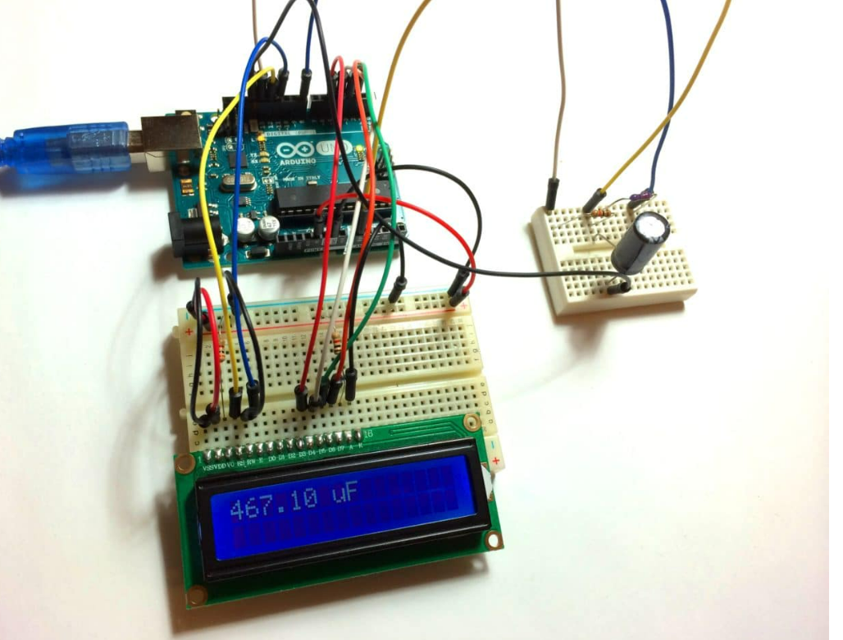
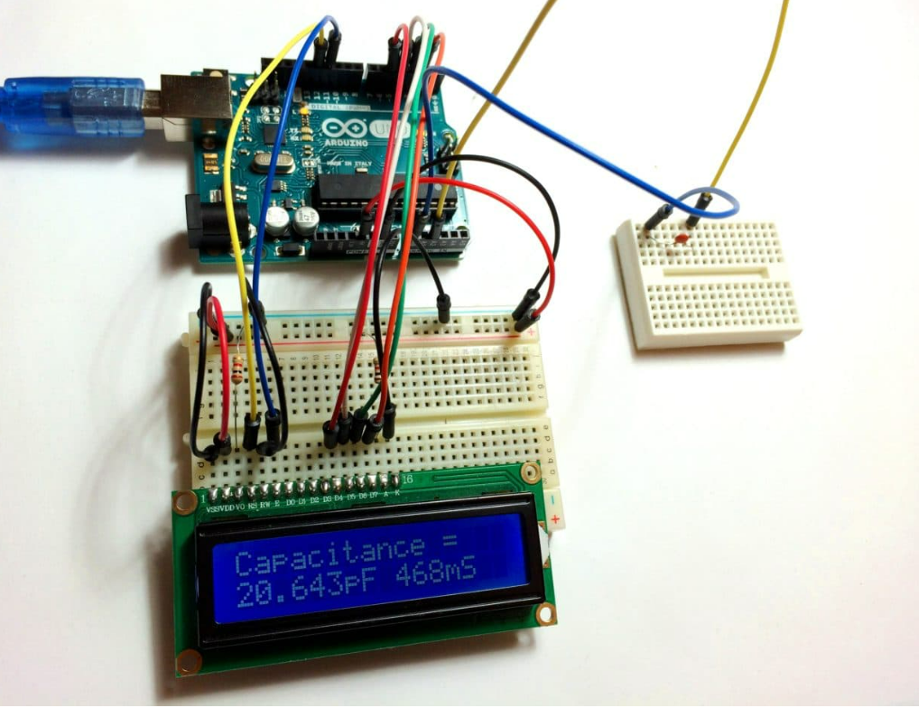

Slide 6
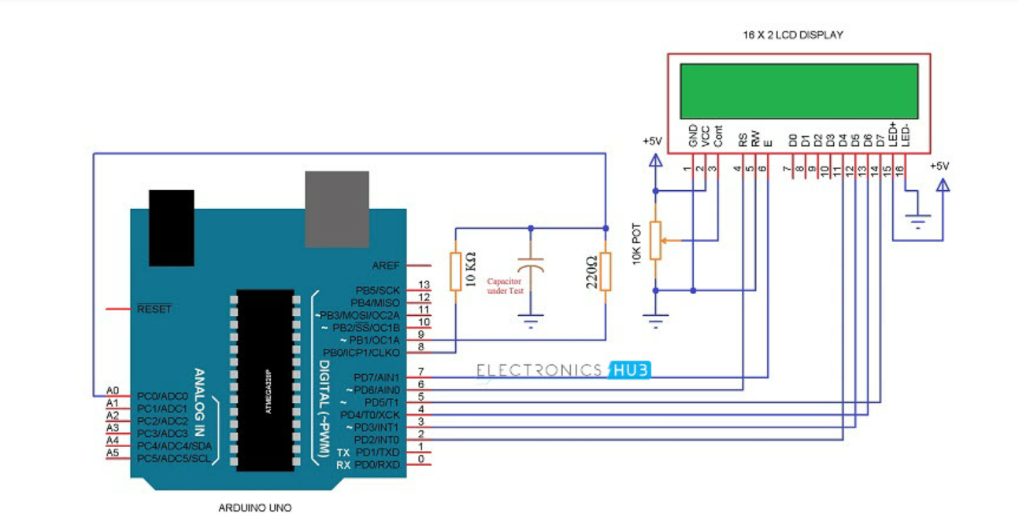
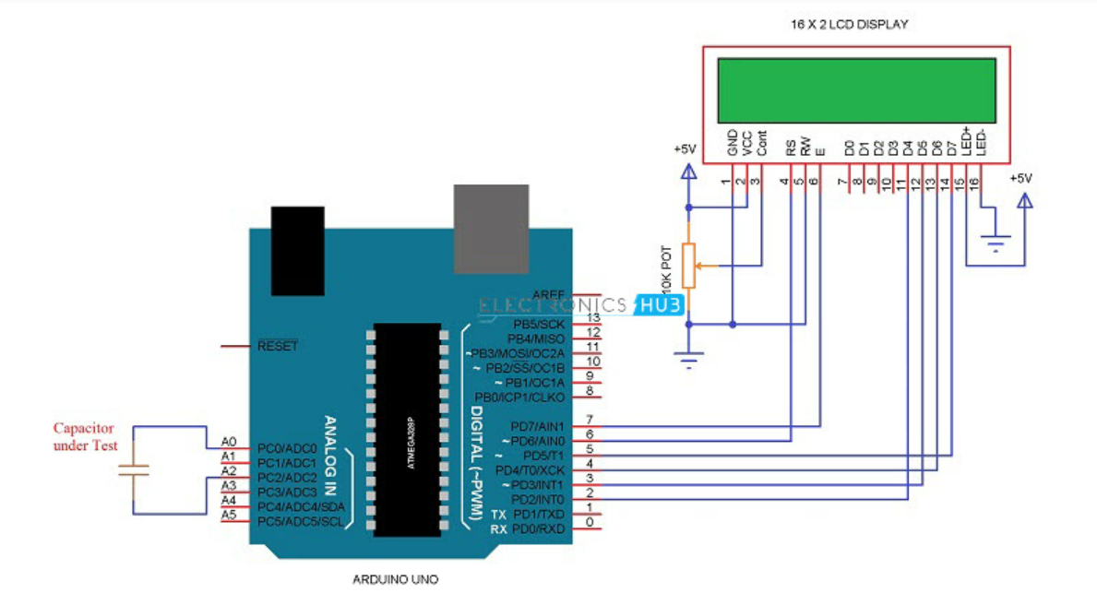
Circuit Diagrams

Slide 7
Timeline
Completion of CIRCUIT 1 - 30/01/2023
Completion of CIRCUIT 2 - 03/02/2023
Completion of project - 05/02/2023
Final test of the project – 06/02/2023

